Slide 1
FLU SEASON PREPARATION CASE STUDY
Austin Crehan

Slide 2
Flu SEASON PREPARATION
Overview: Help a medical staffing agency that provides temporary workers to clinics and hospitals on an as-needed basis plan for flu season, a time when additional staff are in high demand.
Objective: Examine trends in influenza and how they can be used to proactively plan for staffing needs across the country.
DATA
TOOLS
SKILLS
Influenza Deaths Data provided by the CDC
U.S. Census Data provided by the CDC
Influenza Lab Tests Data provided by the CDC
Influenza Hospital Visits Data provided by the CDC
Excel
Tableau
Translating business requirements
Data cleaning
Data integration
Hypothesis testing
Visual analysis
Forecasting
Storytelling with Tableau

Slide 3
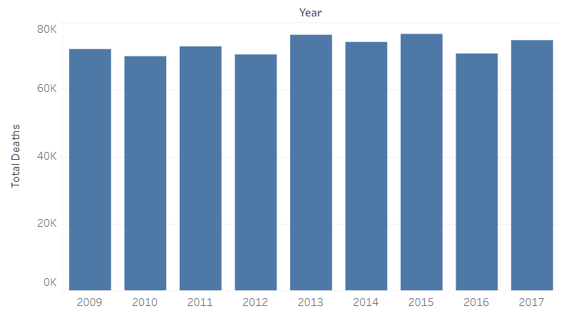
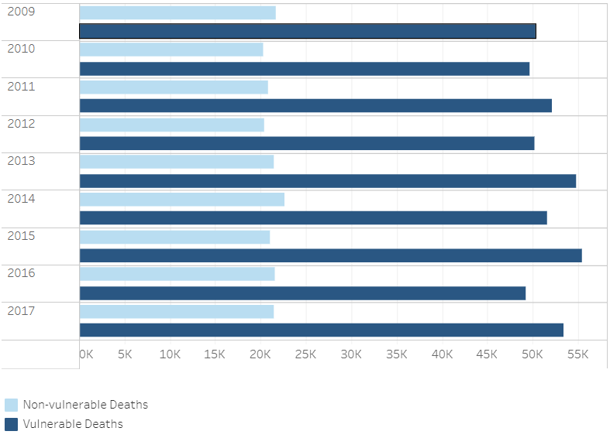
Flu deaths and vulnerable populations
The CDC refers to vulnerable populations as patients more likely to develop flu complications and require additional care
These populations include adults over 65 years old and children under 5 years old, pregnant women, and individuals with HIV/AIDs, cancer, heart disease, stroke, diabetes, asthma, and children with neurological disorders
The Flu continues to be a leading cause of death in the United States
In 2017, 74,849 Americans died from the Flu
Over 70% of Flu deaths come from vulnerable populations
Flu Deaths by Year
Vulnerable vs. Non-vulnerable Flu Deaths

Slide 4
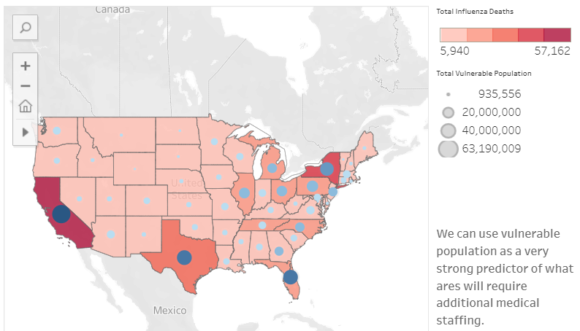
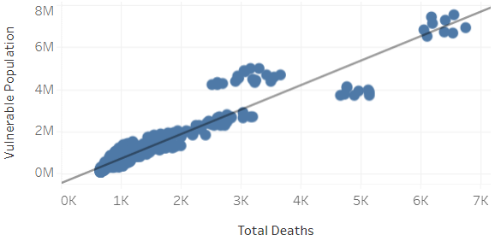
Flu deaths and vulnerable populations
Vulnerable population and flu deaths by state
States with larger blue bubbles have a higher vulnerable population, states shaded darker red have higher Flu deaths
We see a strong correlation between a state’s vulnerable population and flu death total
We can use a state’s vulnerable population as a very strong predictor of what areas will require additional medical staffing

Slide 5
Flu season preparation recap
RESULTS
FURTHER ANALYSIS TO CONDUCT
In 2017, 74,849 Americans died from the Flu
Over 70% of Flu deaths come from vulnerable populations
We can use a state’s vulnerable population as a very strong predictor of what areas will require additional medical staffing
Can we further examine vulnerable populations within a state? Do vulnerable populations reside in more urban or rural areas?
Could we examine health/fitness trends to predict future vulnerable populations?
Within the CDC’s definition of vulnerable populations, are there varying Flu death rates? Does a 70-year-old patient with heart disease have the same Flu death rate as a 35-year-old pregnant patient?
LINKS
Tableau
Video presentation

